Slide 1
Spectrum
Presenter:
Radhika Gupta(2210992112)
Submitted to:
Mr. Sachin Garg

Slide 2
PROJECT OVERVIEW
Our project combines two different things: The MBTI personality test and technology that recognizes hand movements.
We want to make it easier for people to do the personality test by using hand gestures instead of answering lots of questions.
When someone wants to answer 'yes' to a question, they just need to open their hand. If they want to answer 'no,' they can close their hand. It's like saying 'yes' or 'no' with a hand signal.
This way, people can do the personality test in a fun and easy way, just by moving their hands. It's a new and cool way to understand yourself better!

Slide 3
Personality Traits: Introversion, Extroversion, and Ambiversion
Introversion : In our project, introversion is represented by individuals who prefer to answer most questions with closed hand gestures, indicating a preference for solitude and personal reflection.
Extroversion : Extroversion is reflected in individuals who prefer to answer most questions with open hand gestures, signaling a desire for social interaction and engagement.
Ambiversion : Ambiversion is seen in individuals who may alternate between open and closed hand gestures, demonstrating a balance between social interaction and personal reflection.
Project Alignment : Our project aligns with these personality traits by providing an innovative way for individuals to express their preferences through hand gestures, helping them better understand their own personality tendencies.

Slide 4
PROJECT IMPLEMENTATION AND TECH STACK
Description: Our project combines two technologies: Myers-Briggs Type Indicator (MBTI) assessment and gesture recognition.
Programming Language: Python
Libraries: OpenCV, Mediapipe, Time ,Tkinter
Integration logic: Hand gestures are mapped to MBTI responses, allowing users to answer questions using gestures instead of traditional input methods.where the open hand translates to YES and close hand to NO.
Implementation: We leverage the capabilities of OpenCV and Mediapipe to detect hand gestures in real-time and interpret them as MBTI responses.

Slide 5
LIBRARY INTEGRATION
OpenCV : We integrate OpenCV for capturing video frames from the camera and processing them to extract hand gestures.
Mediapipe : We seamlessly integrate Mediapipe for real-time hand tracking and landmark detection, enabling accurate gesture recognition.
Tkinter: Creates a user-friendly interface for interaction.
Time Integration: Incorporates the time library for efficient timing and synchronization within the application.
INTEGRATION ARCHITECTURE
Data Flow : Video frames are captured by OpenCV from the camera feed and processed by Mediapipe for hand tracking and landmark detection.
Gesture Recognition : Detected hand gestures are analyzed and interpreted using custom logic to determine the corresponding MBTI responses.
MBTI Mapping : MBTI responses are mapped to specific personality traits, such as introversion, extroversion, or ambiversion, based on the user's hand gestures.
Real-Time Interaction : The entire process occurs in real-time, allowing users to interact with the system fluidly and receive immediate feedback on their personality traits.

Slide 6
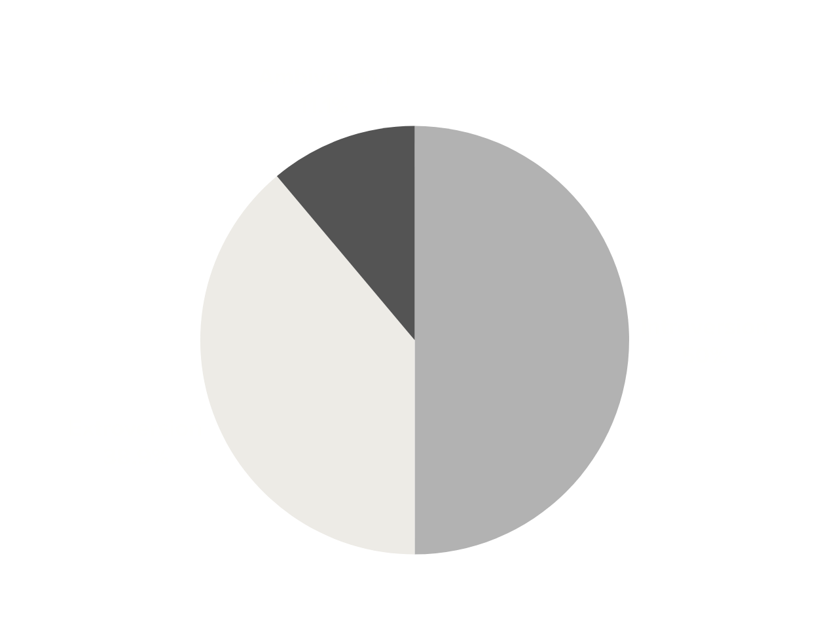
RESULTS INTERPRETATION
Collected responses analysed to identify patterns and trends in users personality types.
Number of participants: 18
Introverts: 9
Extroverts: 7
Ambiverts: 2

Slide 7
SUMMARY
Our project aimed to integrate MBTI with gesture recognition technology for simplified personality assessment.
We developed a system using Python, OpenCV, and Mediapipe to interpret hand gestures as MBTI responses.
Achievements include accurate gesture interpretation and mapping to MBTI traits.
Positive user feedback indicates ease of use and potential for further development.

Slide 8
FUTURE SCOPE
Exploring New Dimensions
Adapting for Different Settings
Collaboration Opportunities
Future directions
Future directions include refining gesture recognition algorithms and exploring new assessment dimensions.
Investigating additional aspects of personality assessment beyond introversion, extroversion, and ambiversion.
Adapting the technology for use in various contexts like education or therapy.
Partnering with others to explore new applications and possibilities.

Slide 9
CONCLUSION
Our project combines psychology and technology to make personality assessment easier.
Thanks to everyone involved for their contributions.
Let's keep exploring and improving to understand human behavior better.

Slide 10
Thank You

